Slide 1
Bank Loan Analysis & Credit Risk Dashboard
End-to-End Data Analytics Project
Prepared by: Mohammad Faiz
Tools Used: MySQL | Power BI | Excel

Slide 2
Project Overview
📌 Objective
The objective of this project is to analyze bank loan data to:
  Understand loan disbursement trends
  Analyse repayment behaviour
  Identify default risk patterns
  Support data-driven lending decisions
Scope:
  Customer-level loan data analysis
  Credit risk segmentation
  Interactive dashboards for insights

Slide 3
Dataset Description
Dataset Overview
  Source: Bank Loan Dataset (CSV)
  Records: Individual loan-level data
  Nature: Historical loan performance data
Key Fields
  Loan Amount
  Interest Rate
  Loan Status
  Grade & Sub-Grade
  Issue Date
  Total Payment
  State & Home Ownership
  Verification Status

Slide 4
Tools & Technology Stack
🛠 Tools Used
Excel: Initial data inspection and formatting
MySQL: Data cleaning, transformation & KPI calculation
Power BI: Interactive analytical dashboard

Slide 5
Data Cleaning & Preparation
🧹 Data Cleaning Steps
Standardized date formats
Corrected data types for numeric and date fields
Handled missing and inconsistent values
Removed unnecessary columns
Created clean master dataset
🗄 Database Processing
Created MySQL tables
Imported cleaned CSV
Validated data integrity
Calculated KPIs using SQL queries

Slide 6
Key Performance Indicators (KPIs)
📈 KPIs Used
Total Customers
Total Loan Amount
Total Amount Paid
Average Interest Rate
Default Rate (%)
💼 Business Value
These KPIs help assess:
Portfolio size
Lending exposure
Repayment performance
Credit risk level

Slide 7
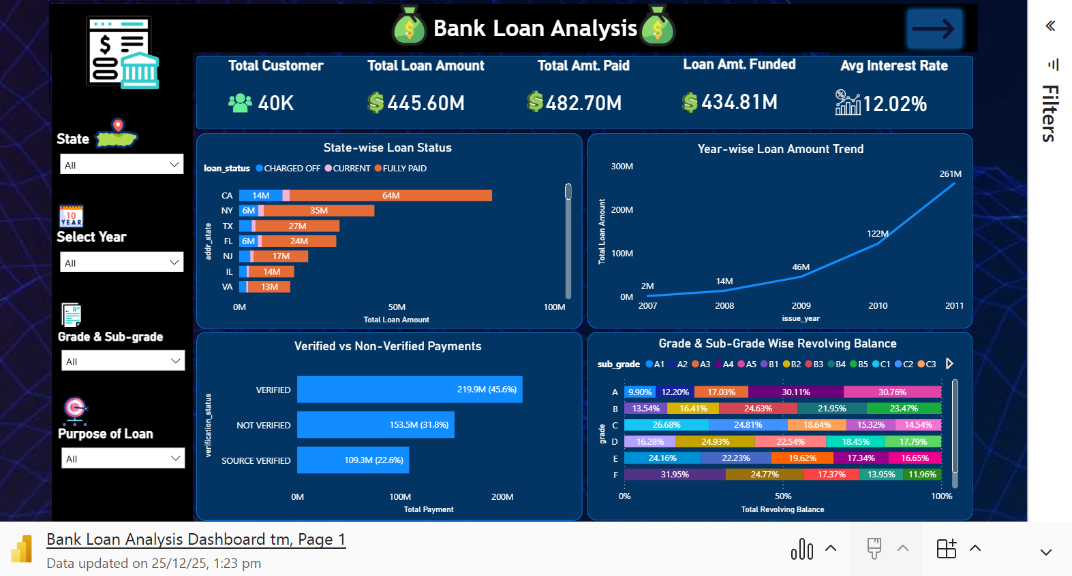
Dashboard & Visual Analysis
To Check Visual Login With Work Mail

Slide 8
Dashboard & Visual Analysis
📊 Key Visuals Created
Year-wise Loan Amount Trend
State-wise Loan Status Distribution
Verified vs Non-Verified Payment Analysis
Grade & Sub-Grade Revolving Balance
Month-wise Loan Status
Home Ownership vs Last Payment Amount
🎛 Filters Used
State
Issue Year
Grade
Loan Status

Slide 9
Key Insights & Findings
🔍 Major Insights
Lower credit grades show higher default rates
Verified customers demonstrate better repayment behavior
Certain states contribute higher charged-off loans
Seasonal trends impact loan issuance and defaults
Home ownership influences repayment capacity

Slide 10
Business Recommendations
Monitor regional credit risk proactively
Encourage income verification for applicants
Adjust lending strategies during high-risk months
Design customized loan products by customer profile
Strengthen credit screening for lower-grade loans

Slide 11
Conclusion & Next Steps
Conclusion
Project delivers a complete view of loan performance and credit risk
Dashboards enable interactive and actionable insights
Supports better lending and risk management decisions
Next Steps
Integrate real-time data
Include external economic indicators
Enhance predictive risk modeling

Slide 12
Thank You

